Slide 1
Driver Behaviour Classification

Slide 2
Objective
Objective: The primary objective of this project is to develop a deep learning-based image classification model that can automatically detect and classify different driver behaviors. The system aims to distinguish between safe driving and various distracted behaviors such as texting, calling, or turning away from the road
The goal is to achieve high classification accuracy and reliable real-time performance.
Model: VGG16, MobileNet and AlexNet

Slide 3
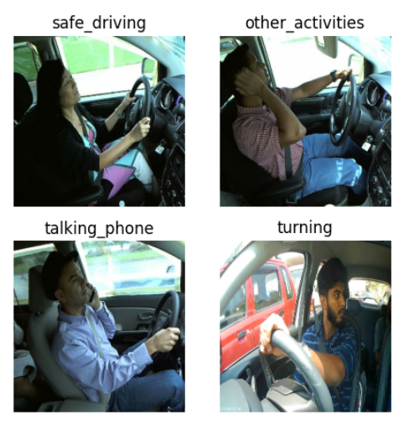
Dataset
Data source: Kaggle
This image dataset contains the major activities of driver classified.
Dataset Includes 5 different class:
Safe_driving
Turning
Other_activities
Talking_phone
texting_phone

Slide 4
Data Preparation
Removed corrupted images.
70% Train, 10% Validation, 20% Test split.
Used stratified sampling.
Stratification ensures that each split maintains the same class distribution. The test set was kept completely unseen during training and model selection.

Slide 5
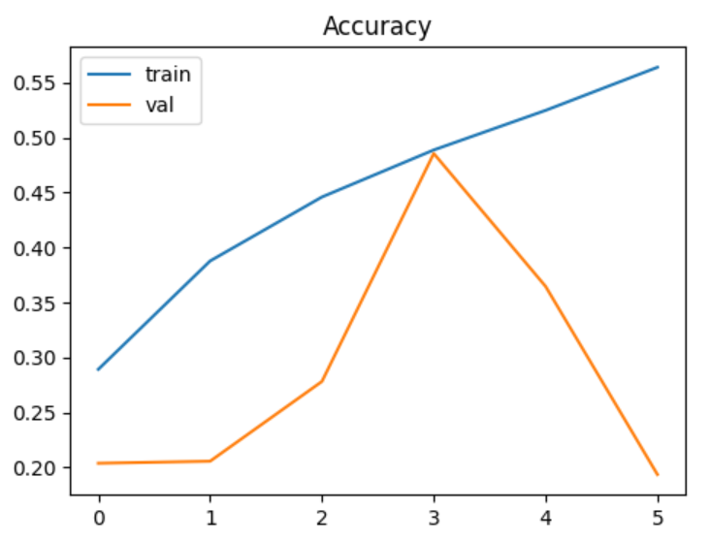
Baseline CNN Model
A simple CNN was implemented as a baseline model. This model was trained from scratch without any pretrained weights.
3 Convolution blocks.
(Conv + BatchNorm + ReLU + MaxPooling)
Global Average Pooling
Dense layer with Dropout
Softmax output layer
Images were normalized by scaling pixel values to
the range [0,1].
Baseline Test Accuracy: 0.4993
Baseline Test loss: 1.1752

Slide 6
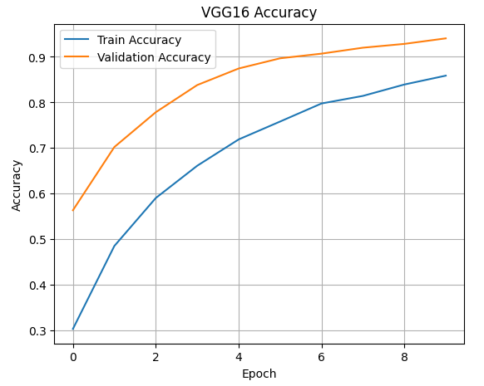
VGG16 Transfer Learning
To improve performance, transfer learning was applied using the pretrained VGG16 model trained on ImageNet.
Two training phases were used:
Feature Extraction:
The convolutional base was frozen.
Only the custom classification head was trained.
Fine-Tuning:
The deeper convolutional layers were unfrozen.
A smaller learning rate was used.
VGG16 Test Accuracy: 0.9335 and VGG16 Test Loss: 0.2753
VGG16 Fine-tuned Test Accuracy: 0.9926
VGG16 Fine-tuned Test Loss: 0.0350

Slide 7
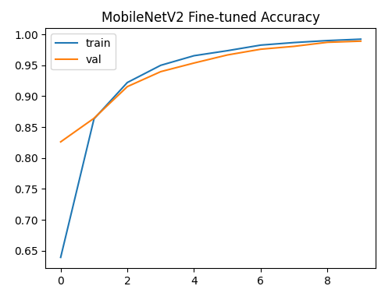
MobileNetV2 Transfer Learning
MobileNetV2, a lightweight architecture optimized for efficiency, was also evaluated using transfer learning.
Similar to VGG16, the model was trained in two stages:
Frozen feature extraction
Fine-tuning with a lower learning rate
MobileNetV2 Test Accuracy: 0.8880
MobileNetV2 Fine-tuned Test Loss: 0.2993
MobileNetV2 Fine-tuned Test Accuracy: 0.9833
MobileNetV2 Fine-tuned Test Loss: 0.0669

Slide 8
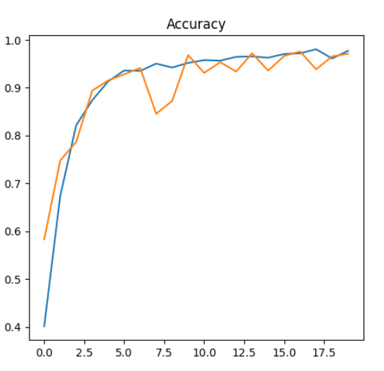
AlexNet
It became famous for its ability to classify images accurately.
Architecture includes:
5 convolutional layers with Max-Pooling
Max-Pooling uses a 3×3 filter with stride 2 which improved performance by reducing top-1 error by 0.4% and top-5 error by 0.3% compared to non-overlapping pooling.
Followed by 2 fully connected layers each using dropout to prevent overfitting.
Ends with a softmax layer for final classification.
Test Accuracy: 0.9237
Test Loss: 0.1794
Notes:
AlexNet is a deep learning model that made a big impact in image recognition. It won the ImageNet Large Scale Visual Recognition Challenge (ILSVRC) 2012. Stride refers to the number of pixels a convolutional filteror pooling window moves as it slides.

Slide 9
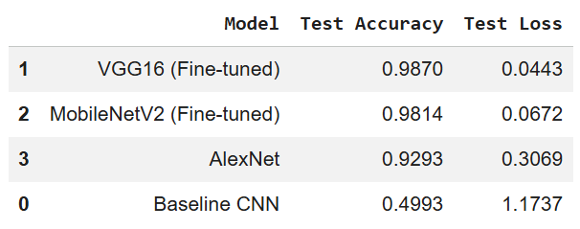
Model Comparison
The baseline CNN achieved moderate accuracy, showed signs of underfitting.
VGG16 – Deep architecture with strong feature extraction capability. Achieved the highest accuracy.
MobileNet – Lightweight architecture, faster training, fewer parameters, efficient for real-time or mobile deployment.
AlexNet achieved competitive accuracy. Larger number of parameters, slower training compared to MobileNet.

Slide 10
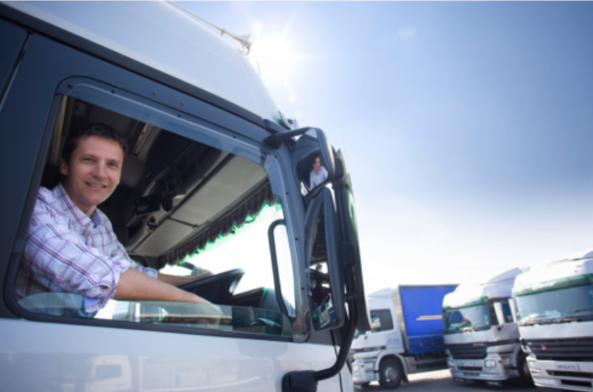
Testing on New Image
VGG16 model prediction
Raw prediction:[[0.1812 0.1952 0.2195 0.2071 0.1967]]
Predicted Class: talking_phone
Confidence: 0.21958415
Mobilenet model prediction
Raw prediction: [[0.0347 0.0823 0.0036 0.0026 0.8766]]
Predicted Class: turning
Confidence: 0.8766074
Alex_model prediction
Raw prediction: [[0.1781 0.0444 0.0214 0.0101 0.7458]]
Predicted Class: turning
Confidence: 0.7458455
Notes:
Classes: ['other_activities', 'safe_driving', 'talking_phone', 'texting_phone', 'turning’]
For VGG16 reasons might be:
Overfitting, don’t judge model on 1 image and may be Dataset diversity is limited..
Solutions: Augmentation, tuning , Test on 20–30 unseen images, Collect More Diverse Images

Slide 11
Conclusion
Developed a deep learning model to classify driver behavior from images.
Model learned meaningful patterns but showed some overfitting on validation data.
Transfer learning improved performance and generalization.
The system shows strong potential for real-time driver monitoring and road safety applications.
Testing on completely new external images revealed some performance variation. This highlights the importance of dataset diversity and real-world variability in improving generalization.
Future improvements may include stronger data augmentation and expanding the dataset with more diverse driving conditions.

Slide 12
Thank You

